Slide 1
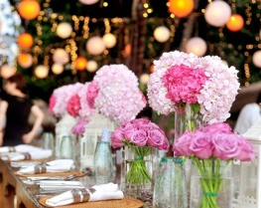


WEDDINGS
425 West Prospect Road, Fort Collins, CO, 80526
Emily.Atwell@atriumhospitality.com | (970) 494-2942

Slide 2

WEDDING ENCHANCEMENTS
COMPLIMENTARY WEDDING ENHANCEMENTS l to customize your wedding
Wedding Packages Include the Following:
Private Ballroom Space
Plate Chargers: Gold or Silver
Table Linen & Napkins: Choice of Color
Silverware, Glassware, China Service
Floating Candle Centerpieces
Elevated Head Table with Up Lighting
White or Black Backdrop
Cake Cutting Service
Champagne or Sparkling Cider Toast
Choice of Menu
Dance Floor
Coffee & Tea Service
Appetizer Display
Non-Alcoholic Beverage Service
Complimentary Tasting for up to 4 Guests
Prices are per person. A customary taxable service charge and sales tax will be added to prices.

Slide 3
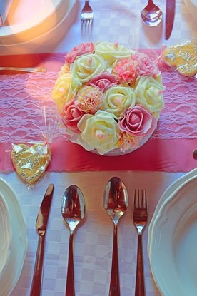
RADIANT PACKAGE
BUFFETS
Emerald: $95.00 per person
Two Starters, Two Sides, Two Entrées
Sapphire: $110.00 per person
Two Starters, Three Sides, Two Entrées, One Carved Item
Diamond: $125.00 per person
Three Starters, Four Sides, Three Entrées, One Carved Item
APPETIZER DISPLAY
Choose one of the following options. Displays included in the package price
Fruit Display
Selection of the Season’s Best with Yogurt Dip
Vegetable Crudité
Served with Hummus or Spinach & Artichoke Dip
Cheese Display
Imported & Domestic Variety of Cheese with Assorted Crackers & Nita Crisps
Prices are per person. A customary taxable service charge and sales tax will be added to prices.

Slide 4

RADIANT PACKAGE CONTINUED
STARTERS
Butternut Squash Soup
Red Pepper & Tomato Bisque
Lobster Bisque
Creamy Mushroom Soup
Field Green: Spring Mix, Grape Tomatoes, Cucumbers, Carrots, & Croutons. Served with a Balsamic Vinaigrette
Kale Salad: Kale, Spinach, Cherries, Walnuts, & Feta Cheese. Served with an Apple Vinaigrette
Traditional Wedge Salad: Baby Iceberg, Bacon, Grape Tomatoes, & Bleu Cheese Crumbles. Served with Ranch
Traditional Caesar: Romaine, Shaved Parmesan, Croutons, & Caesar Dressing
Prices are per person. A customary taxable service charge and sales tax will be added to prices.

Slide 5
RADIANT PACKAGE CONTINUED
SIDES
Rosemary Roasted Potatoes
Garlic & Chive Mashed Potatoes
Au Gratin Potatoes
Rice Pilaf
Creamy Polenta
Charred Broccolini with Garlic Chili Oil
Grilled
ENTRÉES
Herb Roasted Chicken with Lemon Herb Jus
Beef Short Ribs with Red Wine Jus & Crispy Onions
Beef Medallions with Caramelized Pearl Onions & Demi-Glace
Salmon with a Roasted Red Pepper Vinaigrette
Pork Loin with Caramelized Apples & a Mustard Cream Sauce
Wild Mushroom Risotto
CARVED SELECTIONS
Prime Rib
Roasted Turkey Breast
Pork Loin
NY Striploin
Salmon
Prices are per person. A customary taxable service charge and sales tax will be added to prices.

Slide 6
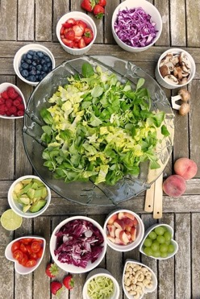
MARQUIS PACKAGE
PLATED DINNER
Plated Dinners Include the Following:
Wedding Package
Choice of Appetizer Display
Fresh Baked Rolls, Choice of Starter, Choice of Entrée
APPETIZER DISPLAY
Choose one of the following options. Displays included in the package price
Fruit Display
Selection of the Season’s Best with Yogurt Dip
Vegetable Crudité
Served with Hummus or Spinach & Artichoke Dip
Cheese Display
Imported & Domestic Variety of Cheese with Assorted Crackers & Nita Crisps
Prices are per person. A customary taxable service charge and sales tax will be added to prices.

Slide 7
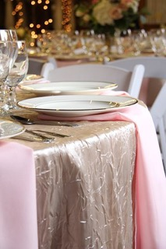
MARQUIS PACKAGE CONTINUED
STARTERS
Butternut Squash Soup
Red Pepper & Tomato Bisque
Lobster Bisque
Creamy Mushroom Soup
Field Green: Spring Mix, Grape Tomatoes, Cucumbers, Carrots, & Croutons. Served with a Balsamic Vinaigrette
Kale Salad: Kale, Spinach, Cherries, Walnuts, & Feta Cheese. Served with an Apple Vinaigrette
Traditional Wedge Salad: Baby Iceberg, Bacon, Grape Tomatoes, & Bleu Cheese Crumbles. Served with Ranch
Traditional Caesar: Romaine, Shaved Parmesan, Croutons, & Caesar Dressing
Prices are per person. A customary taxable service charge and sales tax will be added to prices.

Slide 8
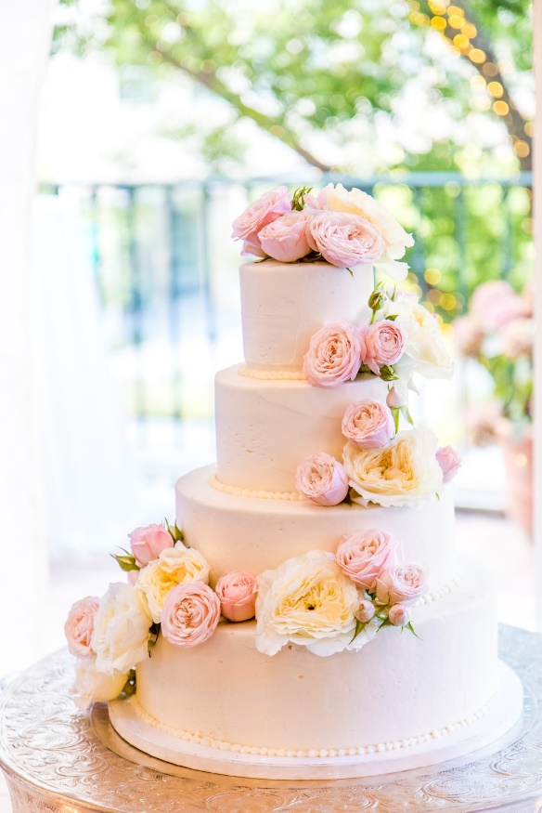
MARQUIS PACKAGE CONTINUED
ENTRÉES
Wild Mushroom Risotto | $84 per person
with Mascarpone, Parmesan Cheese, & a Balsamic Reduction
Portabella Mushroom Steaks | $84 per person
with Rosemary Roasted Potatoes & Haricot Verts
Airline Chicken Breast | $92 per person
with Garlic Chive Mashed Potatoes, Grilled Asparagus, & a Lemon Jus
Pork Tenderloin Medallion | $90 per person
with Blackberry Port Reduction, White Cheddar Polenta, & Seasonal Vegetables
Grilled Salmon | $98 per person
With Rice Pilaf, Grilled Asparagus, Lemon & Thyme Butter Sauce
Beef Short Rib | $98 per person
With Horseradish Mashed Potatoes, Grilled Broccolini, Au Jus, & Crispy Onions
Beef Tenderloin | $104 per person
with Fingerling Potatoes, Grilled Asparagus & a Mushroom Demi-Glace
Prices are per person. A customary taxable service charge and sales tax will be added to prices.

Slide 9
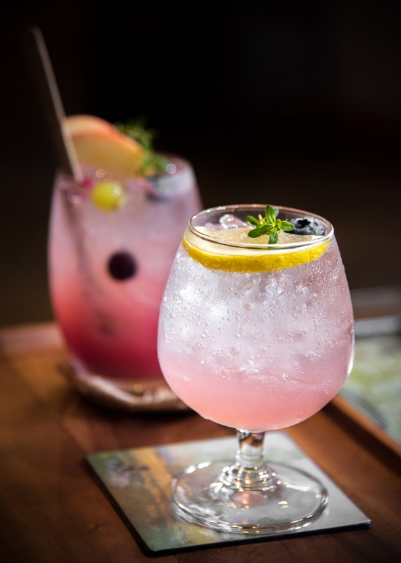
BEVERAGES
Bar Service | based on consumption
 | Cash | Hosted
Classic Liquor | 8.00 | 7.50
Classic Cocktail | 10.00 | 9.00
Classic House Special | 7.00 | 6.50
Premium Liquor | 10.00 | 9.50
Premium Cocktail | 12.00 | 11.00
Premium House Special | 9.00 | 8.50
Classic Wine/By the Glass | 9.00 | 8.00
Premium Wine/By the Glass | 12.00 | 11.00
Domestic Beer | 6.00 | 5.00
Imported Beer | 7.00 | 6.00
All Bars Require a Bartender Fee of $150++ Per Bar.
Prices are per person. A customary taxable service charge and sales tax will be added to prices.

Slide 10

BEVERAGES
BEVERAGE LIST | hosted or cash bar on consumption
Beer
Angry Orchard, Blue Moon, Bud Light, Coors Light, Dogfish Head 60 IPA, Guinness, Heineken, Michelob Ultra, Miller Lite, Stone IPA, Truly, Weihenstephanier, Hefe Weissbier
Classic Liquor
New Amsterdam Vodka, Don Q Cristal Rum, Gordan’s Gin, Jim Beam, Camarena Silver Tequila, Grant’s Scotch, E&J Brandy
Classic Wine
Chloe: Cabernet Sauvignon, Pinot Noir, Merlot, Chardonnay, Pinot Grigio, Prosecco 0
Premium Liquor
Ketel One, Bacardi Superior, Hendrick’s, Maker’s Mark, Casamigos Reposada Tequila, Johnnie Walker Black, Courvoisier VSOP
Premium Wine
Silver Totem Cabernet Sauvignon, H Red Blend, Imagery Pinot Noir, Decoy Merlot, Rodney Strong White Zin, Chalk Hill RRV Chardonnay, Clos Pegase Sauvignon Blanc, Santa Margherita Pinot Grigio, Vietti Moscato, Benvolio Sparkling
All Bars Require a Bartender Fee of $150++ Per Bar.
Prices are per person. A customary taxable service charge and sales tax will be added to prices.

Slide 11
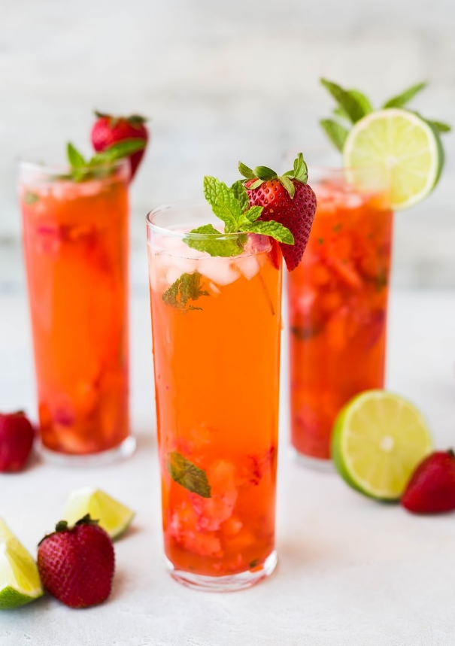
BEVERAGE PACKAGES
HOSTED HOUR BAR | Pricing is per person/per hour with a minimum of 25 guests
Mimosa Bar | First Hour l $12
Orange, Cranberry, & Apple Juices | Second Hour l $10
Prosecco | Each Additional Hour l $8
Old Fashioned Bar | First Hour l $18
Cherries & Simple Syrup | Second Hour l $15
Whiskey | Each Additional Hour l $12
Margarita Bar | First Hour l $14
Traditional, Strawberry, & Mango Mixes | Second Hour l $12
Silver Tequila | Each Additional Hour l $10
Mule Bar | First Hour l $14
Ginger Beer, Cranberry Juice | Second Hour l $12
Vodka | Each Additional Hour l $10
All Bars Require a Bartender Fee of $150++ Per Bar.
Prices are per person. A customary taxable service charge and sales tax will be added to prices.

Slide 12

ENHANCEMENT UPGRADES
UPGRADED ENHANCEMENTS | for an even more tailor-made event
Slideshow Package l $400
iPod Support Package l $65
Additional Up Light l $35 each
Candy Display l Starting at $8/person
Chocolate Covered Strawberries l $48/dozen
Heart Gobo l $200
Personalized Gobo on Dancefloor l $200
Separate Room for Cocktail Hour l Starting at $500
Printed Menus l $2 Each
Specialty Linens l Pricing Available on Request
Prices are per person. A customary taxable service charge and sales tax will be added to prices.

Slide 13
POST WEDDING BRUNCH
Priced Per Person
EVER AFTER | 32
Seasonal Fruit Platter with Fresh Berries
Cinnamon Rolls & Danishes
Fluffy Buttermilk Pancakes
Biscuits & Gravy
Scrambled Eggs
Denver Scrambled Eggs with Ham, Peppers, Onions, & Cheddar Cheese
Bacon & Sausage Patties
Home Fries with Peppers & Onions
LOVLEY MORNING | 31
Seasonal Fruit Platter with Fresh Berries
Fruit Smoothie Shooters
Assorted Low-Fat Yogurt & Granola
Assorted Bagels & Cream Cheese
Oatmeal
Scrambled Egg Whites
Turkey Bacon & Chicken Apple Sausage
Roasted Red Potato Wedges
BON VOYAGE l $20
Seasonal Fruit Platter with Fresh Berries
Variety of Freshly Baked Breakfast Breads & Pastries
Assorted Breakfast Bars
Assorted Botted Juices
Freshly Brewed Coffee with “To-Go” Cups
All Breakfast Buffets Include
Orange and Cranberry Juices
Butter, Jams, Fruit Preserves and Honey
Freshly Brewed Coffee
Assorted Herbal Teas
Prices are per person. A customary taxable service charge and sales tax will be added to prices.

Slide 14
INFORMATION | POLICIES
AGREEMENT TO BANQUET EVENT POLICIES
GUARANTEES ON ALL FOOD & BEVERAGE:
We need your assistance in making your function a success. Please confirm your attendance at least 3 business days in advance. This will be considered your minimum guarantee and is not subject to reduction. If no guarantee is received, the original expected attendance on your Banquet Event Order will be used. Charges are predicated upon factors pertaining to the entire program. Revisions in your group counts, times, dates, set-up, or meal functions may necessitate renegotiating the charges.
BILLING:
Final payment is due three (3) days prior to the event.
SERVICE CHARGE:
All audio visual, food/dining & beverage is subject to a service charge of 25% which is taxable .
TAXES:
All audio visual, food/dining & beverage is subject to Colorado sales tax.
PAYMENT ARRANGEMENTS:
Cash and credit card payments: All functions must be paid in advance unless direct billing has been approved by our credit manager. Functions may be guaranteed for payment or paid by the following credit cards: American Express, Diner’s Club, Master Card or Visa. Completion of a credit card authorization form is required.
CHECK PAYMENTS:
The hotel will accept a company check, cashiers’ check, money order or personal check. If a check will be used, it must be submitted to the hotel ten (10) days prior to the event arrival date.
SMOKING POLICIES:
Smoking of cigars or cigarettes is not permitted in the public areas or in the Hotel. Compliance with this hotel policy is mandatory and a $250.00 charge will be incurred for any violations.
CANCELLATION POLICIES:
If the hotel is advised that a definite booking is cancelled, a cancellation fee will be charged. The following policy is in effect in the absence of a cancellation clause in the catering or sales confirmation agreement. The cancellation fee for your function is one hundred percent (100%) of the total estimated food, beverage and room rental charges. This cancellation fee will be charged if this function is cancelled less than thirty (30) days from the event date.
CONFIRMATION OF SET-UP REQUIREMENTS:
Final menu items, room arrangements and other details pertaining to this function are outlined on the Banquet Event Order. Unless otherwise stated in the Banquet Event Order, the hotel reserves the right to change function rooms at any point should the number of attendees decrease, increase, or when the hotel deems it necessary.

Slide 15






CLEANLINESS ASSURED
Temperature checks will be conducted
before entering the event.
Cloth masks will be required for
attendees and staff at a minimum.
KN95 masks will be provided for any
attendee or staff who wants one.
Glove and hand sanitizer stations
will be available throughout the event.
Disinfectant foggers will be placed in
the exhibit hall area.
New appointment design allows for
social distancing measures and plexiglass shields
will be placed on appointment tables.
Indoor/outdoor spaces
will be used as much as possible.
Larger aisle ways and one-way only aisles
in the trade show and appointment areas
help manage traffic.
Education sessions will be set up to
allow for 6’ space between chairs.
F&B will be provided in a no-contact way (i.e. pre-packaged food, no self-serve buffets).
There will be no large general sessions
this year at Atrium.
Atrium is committed to implementing
processes to not only combat this
virus, but promote healthy best
practices that you can adopt at your
own events during high-and low-risk
time periods alike.
Atrium firmly believes that we must
be the leaders in showcasing safe
conferences while still allowing all
attendees to have fun and book
business.

